Slide 1
WELCOME

Slide 2
TOURISM MANAGEMENT
Name:- Sheetal Fegade
Roll No:- 58
Name:- Shraddha Gore
Roll No:- 60
Name:- Ashwini Sapkale
Roll No:- 168
Name:- Siddhi Bage
Roll No:- 07

Slide 3
Name- Shraddha Gore Roll No- 60
https://github.com/shraddha600/Tourism-Management-System
Name:- Sheetal Fegade Roll No:- 58
https://github.com/sheetalfegade/Tourism-Management-System
Name:- Ashwini Sapkale Roll No:- 168
https://github.com/ashwinisapakale1/Tourism-Management-System

Slide 4
Introduction:-
Nowadays, the tourism industry has a major impact on the economy. And so, the tourism industry is becoming more demanding and complex with multilayered desires and needs. As the name specifies “Tourism Management System” is software developed for managing tour booking.
This system help to make strong relationship with customers so that they can enjoy that holiday of their dreams. This system also helps to develop tourism with different cultures so that they enrich the tourist experience and build pride. This system will provide display platform in where a tourist can find their tour places according to their choices. This system will also provide easy and efficient work for agency.

Slide 5
Project features:-
It involves the management of multitude of activities such as studying tour destination, planning the tour, making travel arrangements and providing accommodation. It also involves marketing efforts to attract tourists to travel to particular destinations. It involves accommodation, transportation, food, events, conferences, and other trade-related activities

Slide 6
1. Software Requirements:-
Technology : Open Source
Front end : PHP
Back end : MySQL
Operating system : WINDOWS XP
2. Tool & Technologies Used:-
MySQL
XAMPP (Apache Server)
Visual Studio Code

Slide 7
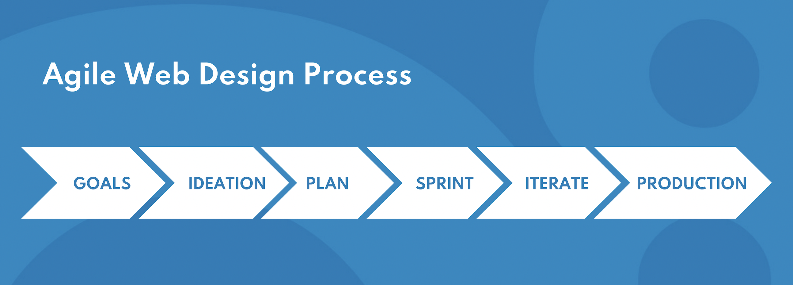
Software Process Using Agile Methodology:-
The agile web development process has multiple steps that usually co-occur. It relies heavily on teamwork, and early team meetings are essential to the project's success. Instead of following a long sequential design process, agile web design involves sprints-- each with a unique goal and timeline
The agile approach will usually include the following steps:
Step 1: Goals
The first step in any web design project is to set clear goals. What are you trying to achieve with your website? Who is the target audience? What needs to be included on the site? Answering these questions helps create a clear roadmap for the project.

Slide 8
Step 2: Ideation
Once the goals are defined, it's time to start generating ideas for meeting them. Here, the assembled design and development team brainstorms with other stakeholders to explore new and innovative ideas for the website.
Step 3: Plan
With a list of ideas/concepts, it's time to start planning how to turn those ideas into reality. This step involves creating a project plan covering user flows, wireframes, and prototypes to help visualize the website. It's essential to keep the customer in mind and, if possible, involved during this step to ensure that the final product meets their needs.
Step 4: Sprint
A sprint is a short, focused period (usually 2-4 weeks) in which the team works on a specific goal. This goal could be anything from designing the home page to adding a new feature to the site. During sprints, staying focused and avoiding scope creep is essential.

Slide 9
Step 5: Iterate
After each sprint, the team takes a step back and subjects the outcome of the sprint to user-centric testing, analysis, and feedback. Data collected from feedback and functionality metrics are reincorporated back into the process, informing the team whether to proceed or tweak the design further. During iteration, the focus is to keep progressing and not get stuck.
Step 6: Production
Once all the project goals have been met, the design is usually production-ready and can move to the development phase. While this might seem like the end of the process, the concept of agile assumes that this step can loop back to any previous stages, depending on any new information arising.

Slide 10
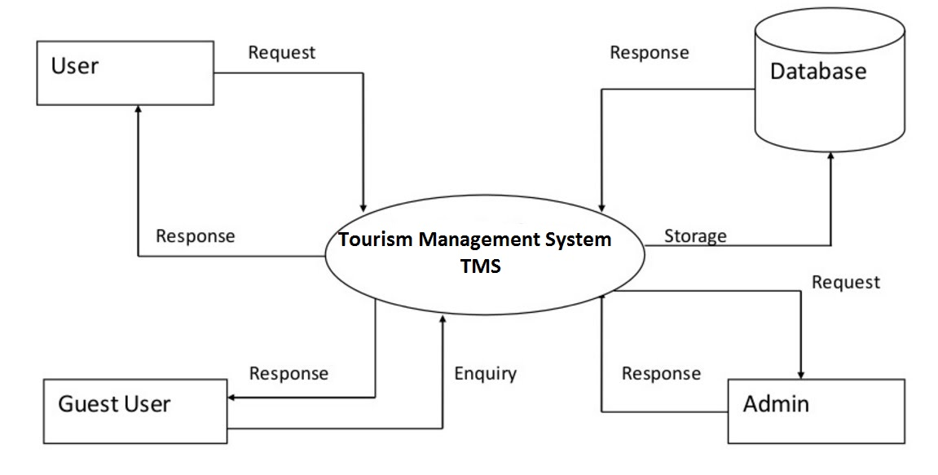
Context level DFD – 0 level

Slide 11
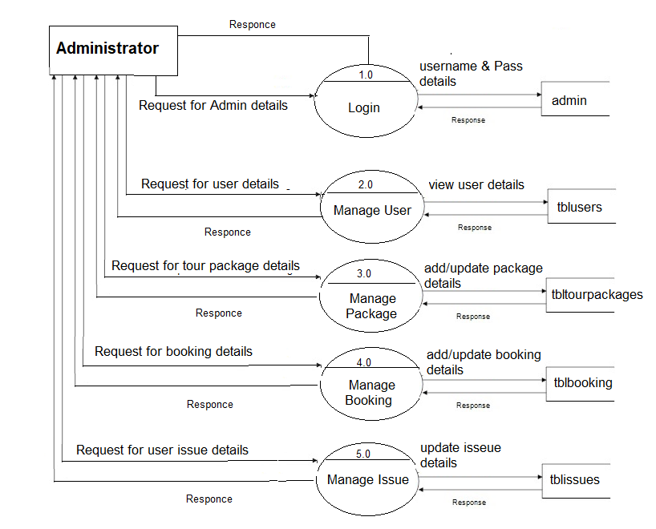
Data Flow Diagram Admin

Slide 12
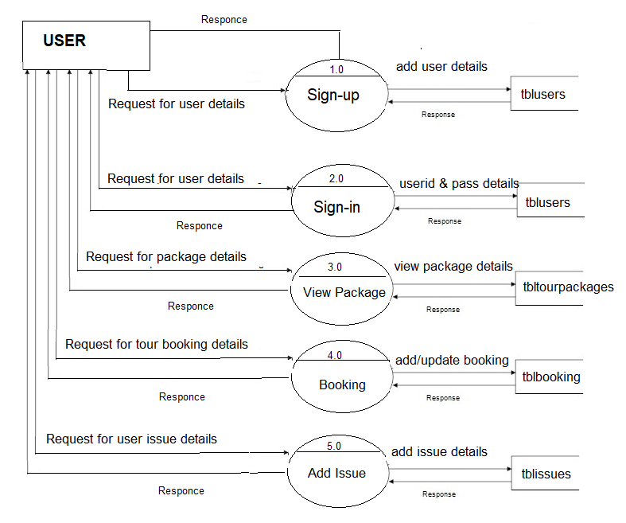
Data Flow Diagram User

Slide 13
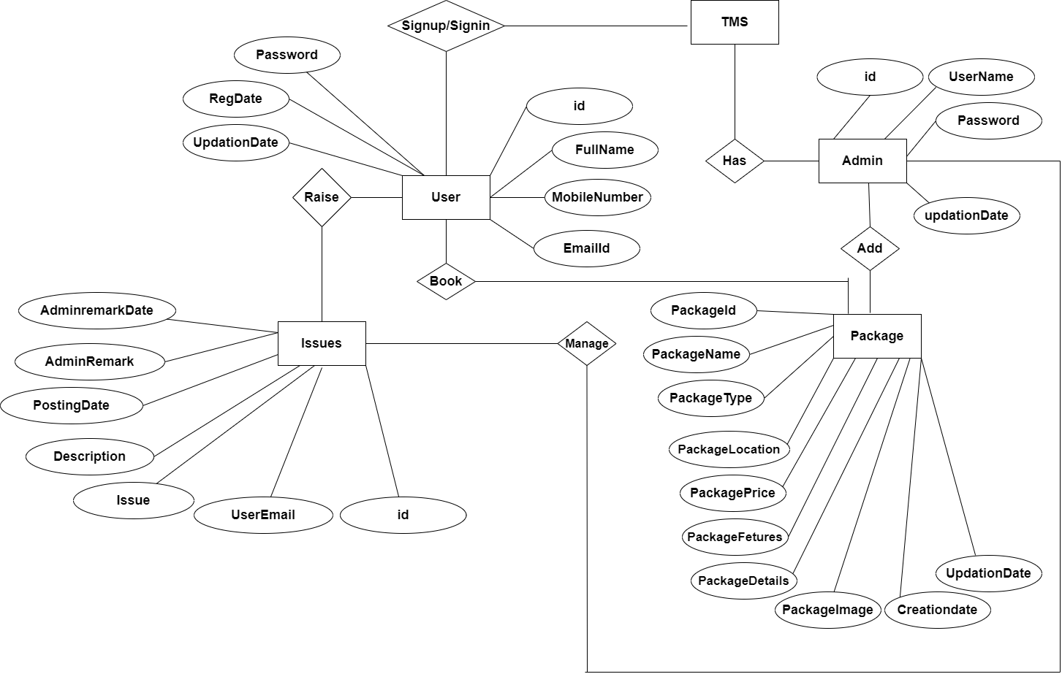
E-R Diagram for Tourism Management:- System

Slide 14
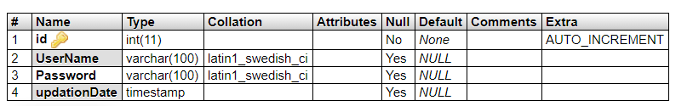
DATABASE DESIGN:-
MySQL Table Design:
Admin Table: This table store the admin login details.

Slide 15
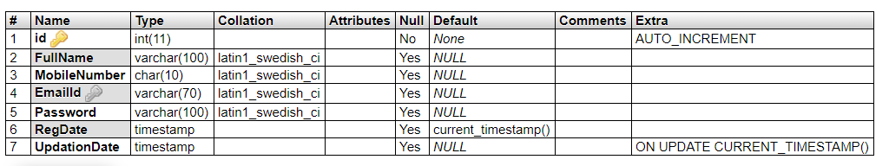
Tableuser Table: This table store the user personal and login details

Slide 16
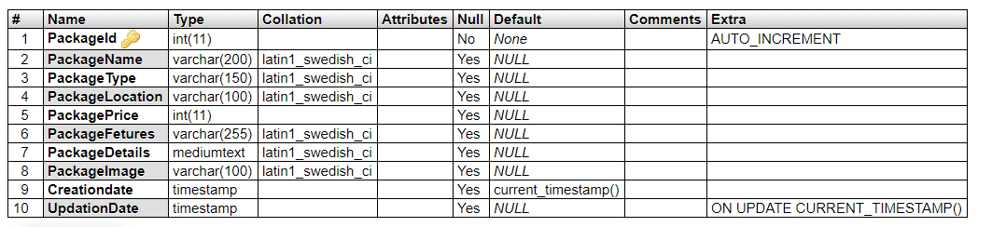
Tabletourpackages Table: This table store the tour package full details.

Slide 17
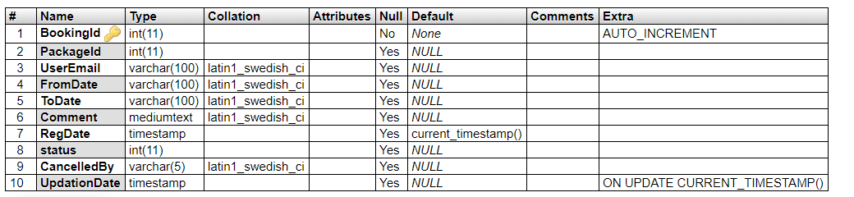
Tablebooking Table: This table store the user booking details.

Slide 18
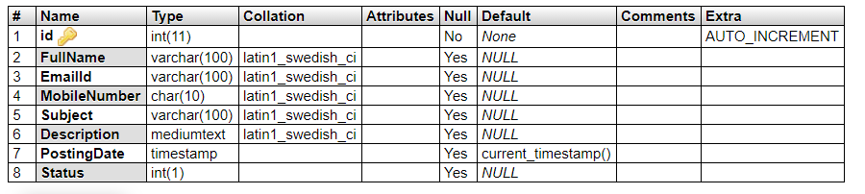
Tblenquiry Table: This table store the user enquiry details.

Slide 19
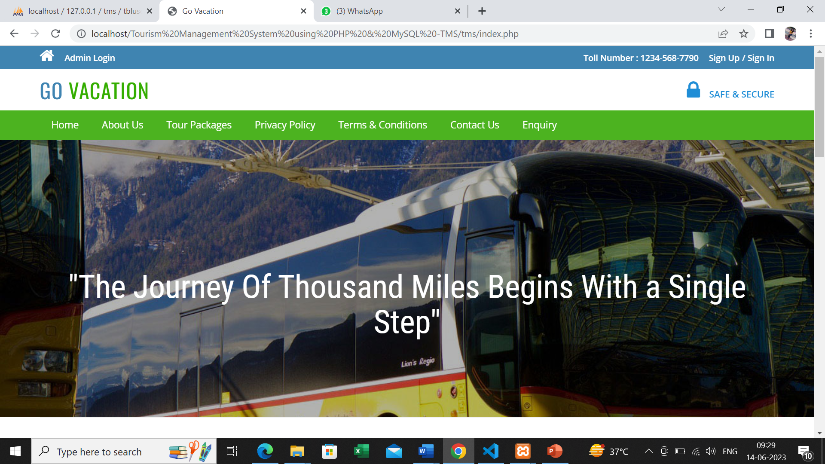
USER INTERFACE:-
Home Page:-

Slide 20
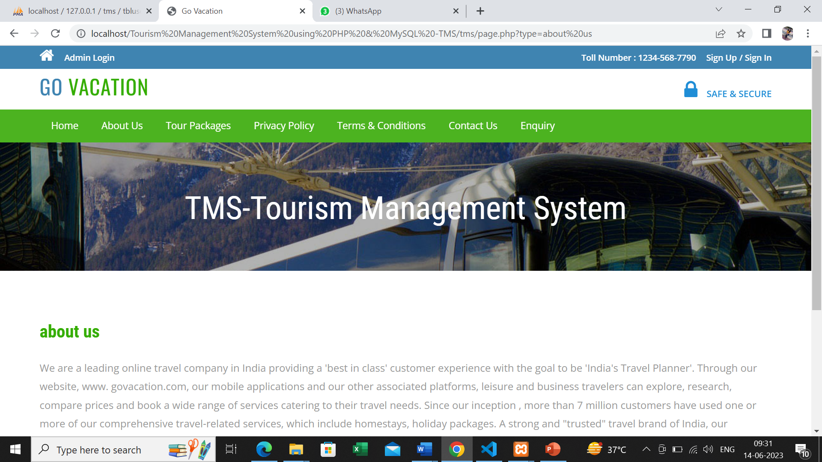
About Us Page:-

Slide 21
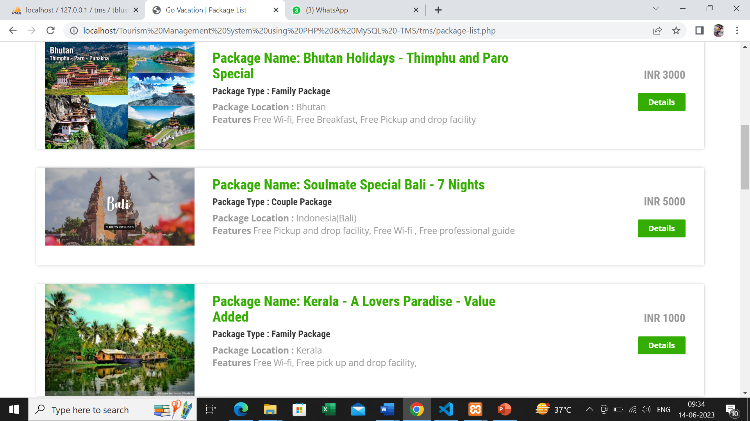
Travels Packages:-

Slide 22
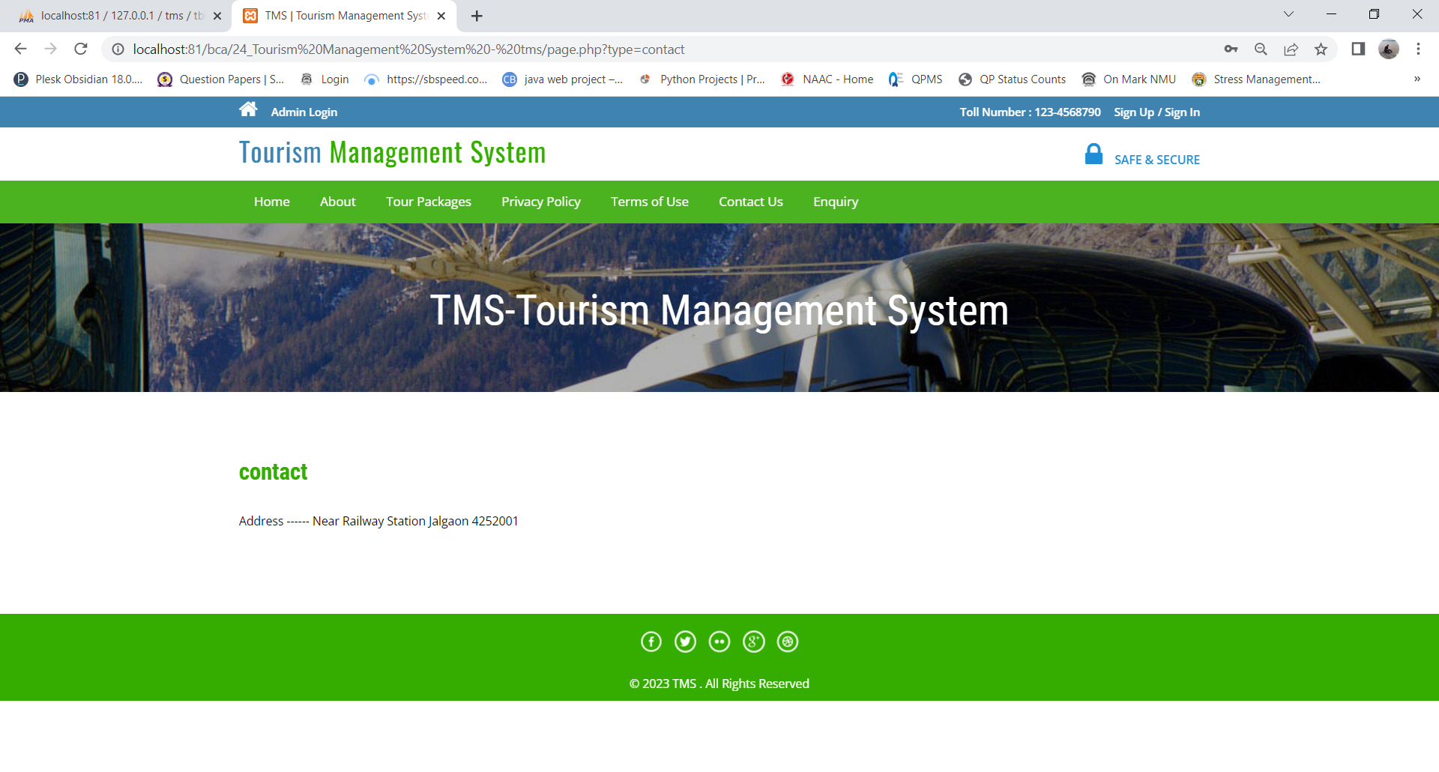
Contact Us Page:-
Contact Us Page

Slide 23

Privacy policy:-

Slide 24
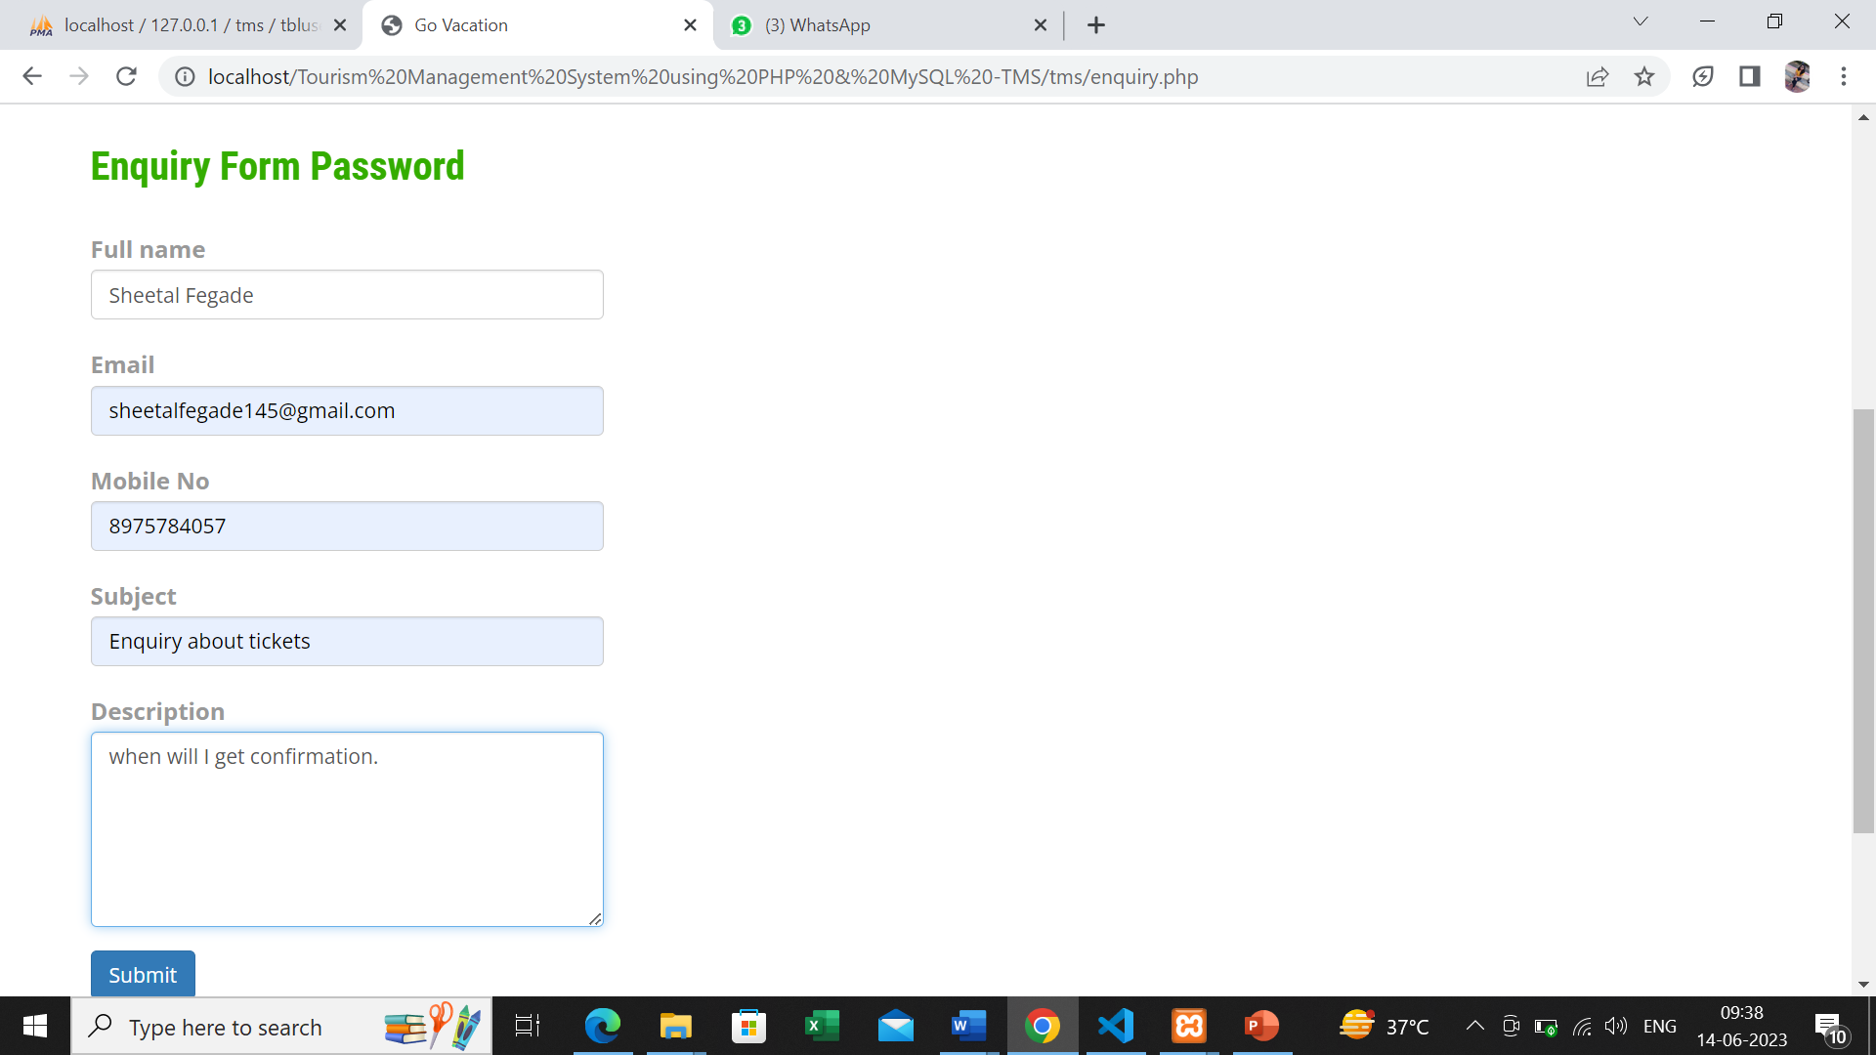
Enquiry Page:-

Slide 25
CONCLUSION:-
This project has given me an ample opportunity to design, code, and test and implements an application.This has helped in putting into practice of various Software Engineering principles and Database Management concepts like maintaining integrity and consistency of data. Further, this has helped me to learn more about MYSQL,PHP,HTML,JAVASCRIPT, Adobe Photoshop 7.0 and Personal Web Server.
I thank my guide for his invaluable contribution in guiding me throughout the project. The project titled as Tourism Management System was deeply studied and analyzed to design the code and implement. All the current requirements and possibilities have been taken care during the project time. Tourism Management System is a web based application, which manages and handles the people tour booking who visited in the tourism agencies.

Slide 26
Future Scope:-
The Website is developed based on real life. It is very helpful in business applications. Today's extremely exhausting work environment dictates that individuals requires some joyful holiday. The website will provides a stress-free joyful refreshing holidays with cost competitive and customized packages according to their requirements. As it is web based it can provide services in almost each and every city of India. It offer tour and travel services including holiday tour packages, domestic tour packages only in one click. It provide the most suitably designed as well as the customized travel packages to the customers. The site will help to estimate the benefits and calculate the requirement very easily. The benefits will be in terms of speedy query

Slide 27
BIBLIOGRAPHY:-
The following books were referred during the analysis and execution phase of the project
PHP and MySQL Web Development
Book by Luke Welling
Head First PHP & MySQL
Book by Lynn Beighley and Michael Morrison
PHP & MySQL for Dummies
Book by Janet Valade

Slide 28
WEBSITES:-
For PHP
https://www.w3schools.com/php/default.asp
https://www.sitepoint.com/php/
https://www.php.net/
For MySQL
https://www.mysql.com/
http://www.mysqltutorial.org
For XAMPP
https://www.apachefriends.org/download.html

Slide 29
THANK YOU !

